Slide 1
SNA using R 0 – intro to workshops
March 2019 – CDPH
Esther.Kukielka@CDPH.ca.gov

Slide 2


Overall Learning objectives
Basic R language usage: data manipulation, cleaning and visualization
Basic terminology of graph theory
Understand key concepts of SNA: Network properties and centrality
Calculate and understand SNA statistics
Import and adapt data to construct networks on R studio
Visualize and map networks
Appropriately and critically interpret results of network analysis
Going beyond: Community algorithms and regression
Going beyond-er: Dynamic networks, Shiny App

Slide 3

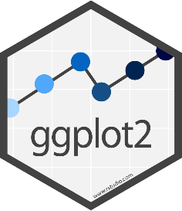
Outline … so far
Topic
Basics in R
Data manipulation with dplyr
Data visualization with ggplot
Network I
Network II
Two workshop per week, 4 weeks total
2h sessions
Reiteration of :
Power point
Coding together
Exercises
This workshop is for you!
Let me know if you would like to change anything or if you have suggestions for improvement
Everything is adaptable

Slide 4

SNA using R 1 – R Basics
March 2019 – CDPH
Esther.Kukielka@CDPH.ca.gov
This workshop heavily borrows from the list of references provided at the end of the presentation

Slide 5
Learning objectives
RStudio basic concepts
Source
Console
Environment/History
Files/Plots/Packages/Help/Viewer
Intro to R
Objects
Data types
Missing data

Slide 6


Concepts
Integrated Development Environment (IDE)

Slide 7
But I am a SAS user!
R is open source
R code is reproducible
R is more flexible
Visualization
Online R community
R is hard
R for SAS users
R for SAS Programmers: It’s different, but friendly
(…to me)
Notes:
Flexibility: SNA, tunning
Visualization: better graphs, shiny, html, pdf..
Online: Support, Easy to share

Slide 8
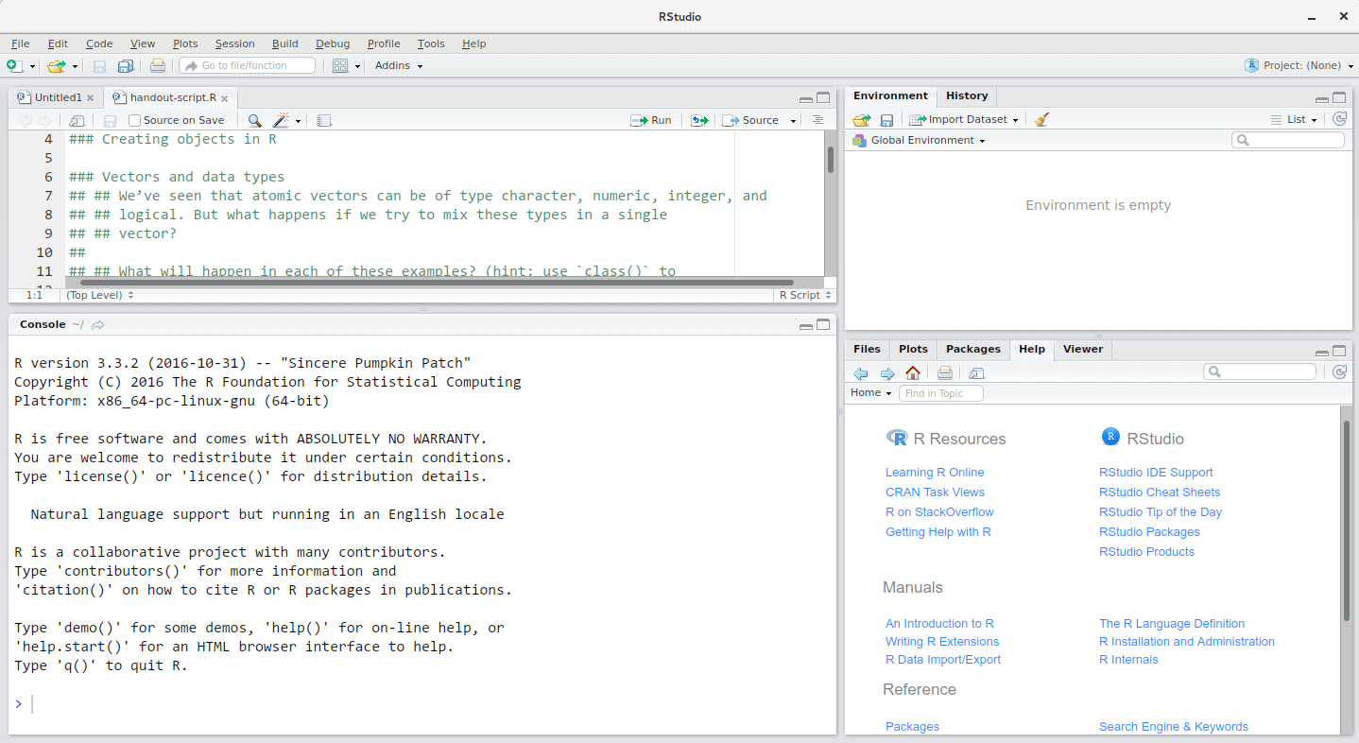
Concepts
Source

Slide 9
Updating R and R-studio
Link1
Link2
Download R:
https://www.r-project.org/ will take you to a list of CRAN mirrors. You can download this one, from UCBerkeley: https://cran.cnr.berkeley.edu/
Download R studio (user friendly platform to use R):
https://www.rstudio.com/products/rstudio/download/#download

Slide 10
Objects and Data types (I)
Create an object
Tabu words (link)
Best to avoid dots (.) within an object name (i.e., my.dataset)
Data types:
Vectors: Contiguous cells containing data. Cells are accessed through indexing operations.
Logical (true/false)
Integer (numeric)
String (characters)
Data frame
Matrices
Factors*
List
TRUE
FALSE
TRUE
1
5.8
984
“ACH”
“John”
“TRUE”

Slide 11
Chunk 1

Slide 12
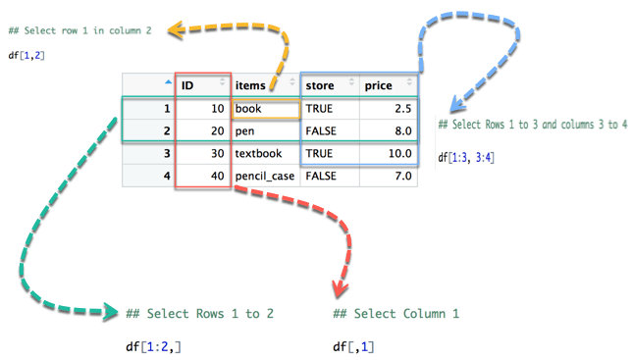
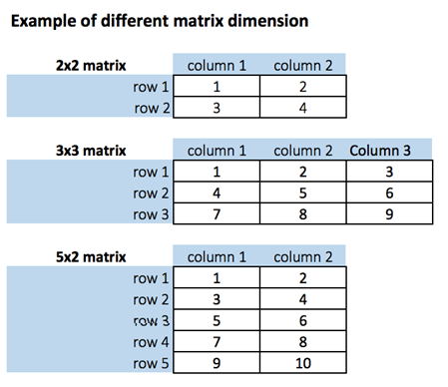
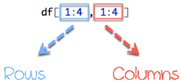
Data types (Ii)
Vectors
Data frames: Relational table (vectors in a data.frame must be the same length). Contents can be of different types. We can also see it as a vector with dimensions.
Matrices: Similar to data frames, but contents must be of the same type.
Indexing: Can be used both to extract part of an object and to replace parts of an object (or to add parts) ➔ library tidyverse (following workshop)
x[i] ➔ vector
x[i, j] ➔ data.frame, matrix
x[[i]] ➔ lists
Notes:
Chunk 2 after Matrices

Slide 13
Chunk 2

Slide 14
Data types (Ii)
Vectors
Data frames: Relational table (vectors in a data.frame must be the same length). Contents can be of different types.
Matrices: Similar to data frames, but contents must be of the same type. We can also see it as a vector with dimensions.
Lists: Lists (“generic vectors” – a compilation of vectors) are another kind of data storage. Lists have components, each of which can contain any type of R object (with different elements), i.e. the components of a list do not have to be of the same type.
Factors* : The way to store categorical (nominal or ordinal – if ordered) variables with k different levels.
***************************************************************************************
Function: “Canned script”. It takes one or more inputs called arguments.
Notes:
Chunk 2 after Matrices

Slide 15
Chunk 3

Slide 16
Missing data
Missing data are represented as NA
Some functions can deal with NA and will just ignore them
Others can only work if you remove those NA. This is the case for arithmetic operations
NA can be returned in your code in different occasions – see Chunk 4 code
Other “null-able” values are:
NULL
NaN
Inf / -Inf

Slide 17
Chunk 4

Slide 18
Learning objectives
RStudio basic concepts
Source
Console
Environment/History
Files/Plots/Packages/Help/Viewer
Intro to R
Objects
Data types
Missing data

Slide 19

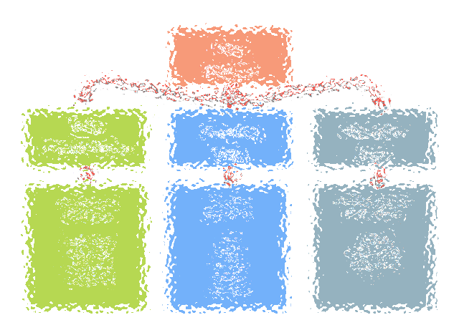
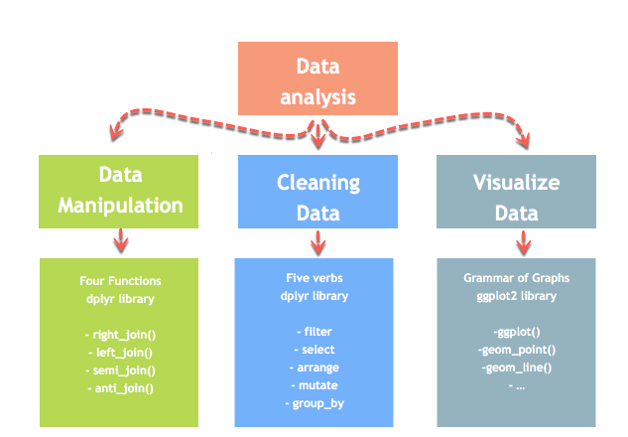

Next time…

Slide 20
Resources and references
Data carpentry: https://datacarpentry.org/R-ecology-lesson
Data types: https://www.statmethods.net/input/datatypes.html
Language definitions: https://cran.r-project.org/doc/manuals/r-release/R-lang.html
R for SAS users
R for SAS Programmers: It’s different, but friendly
Guru 99

